Slide 1
Analysis of Air Quality Index(AQI)
By- Reboot Rebels

Slide 2

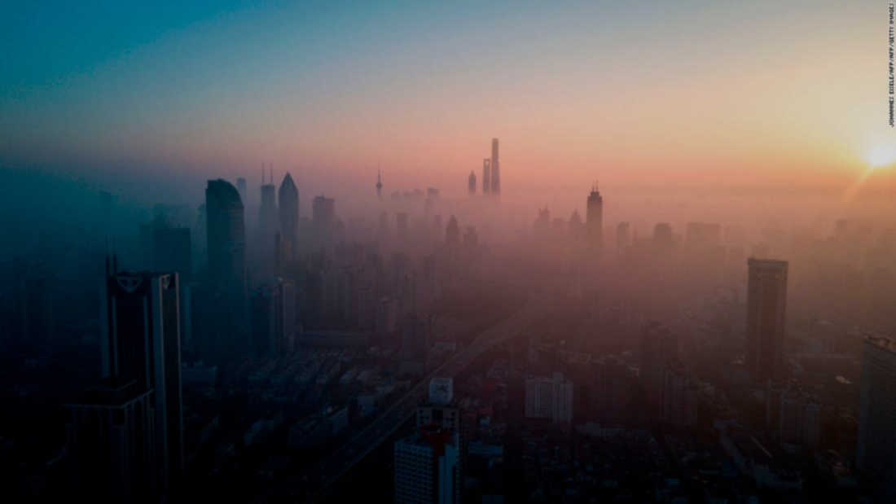
Feeling fresh AIR is The Quality Of Health. -Abdulla Kunnath

Slide 3
OUR PROBLEM STATEMENT
Levels of air pollution in Indian cities are on the rise, responsible for many health problems in the urban areas.
In this project we have analyzed the severity of air pollution measured by API or AQI(Air Quality Index).

Slide 4
ALGOTITHMS USED
LINEAR REGRESSION
RANDOM FOREST

Slide 5
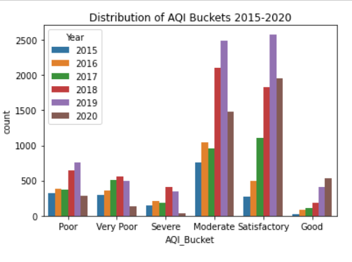
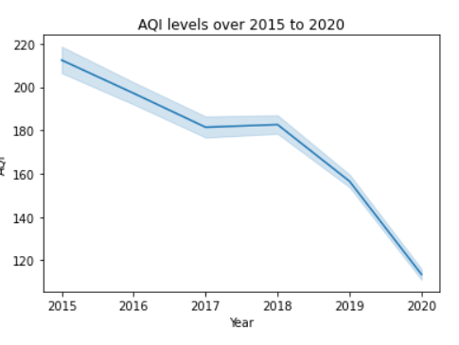

Slide 6
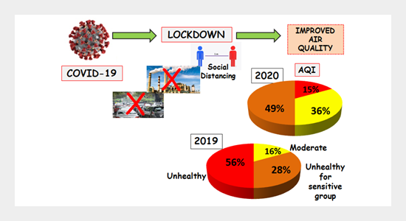

Slide 7
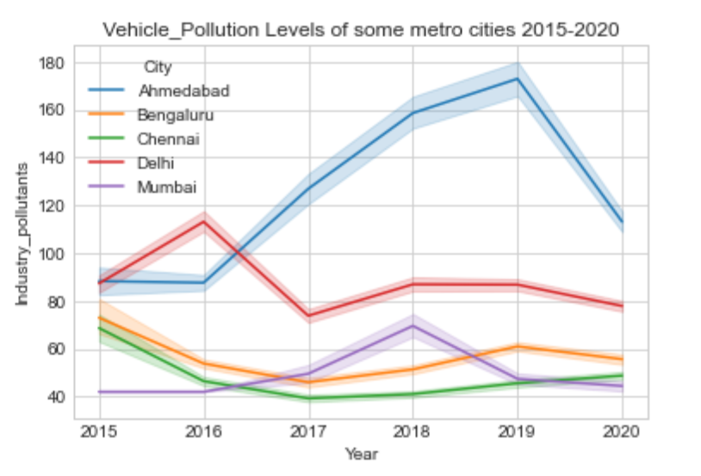
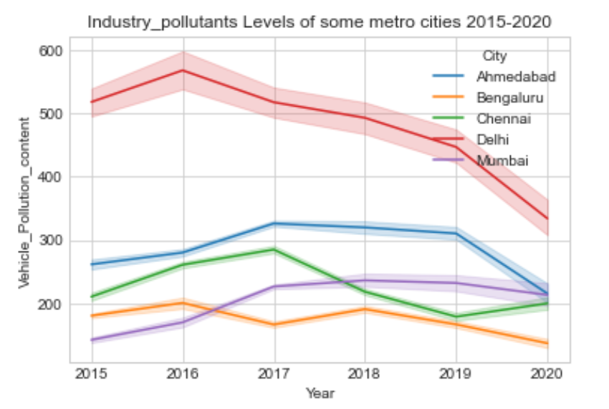
Vehical Pollutants vs Industrial Poullutants over 2015 - 2022

Slide 8
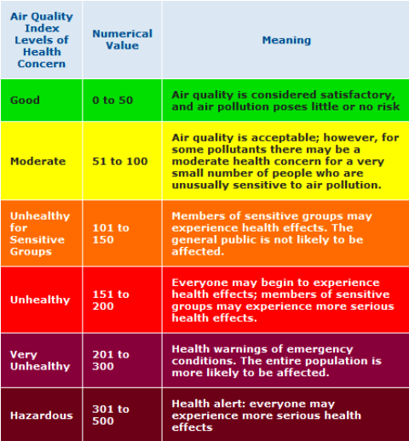

Slide 9
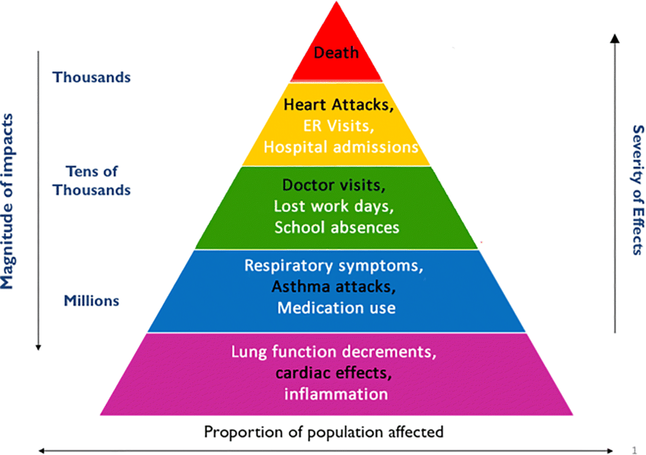

Slide 10
let’s take a look on live Forecast Model Analysis of our country...
The real-time forecast animation, as well as the model efficiency analysis.
https://aqicn.org/forecast/model/sprintars-asia/

Slide 11




SOLUTION of Air Pollution

Slide 12
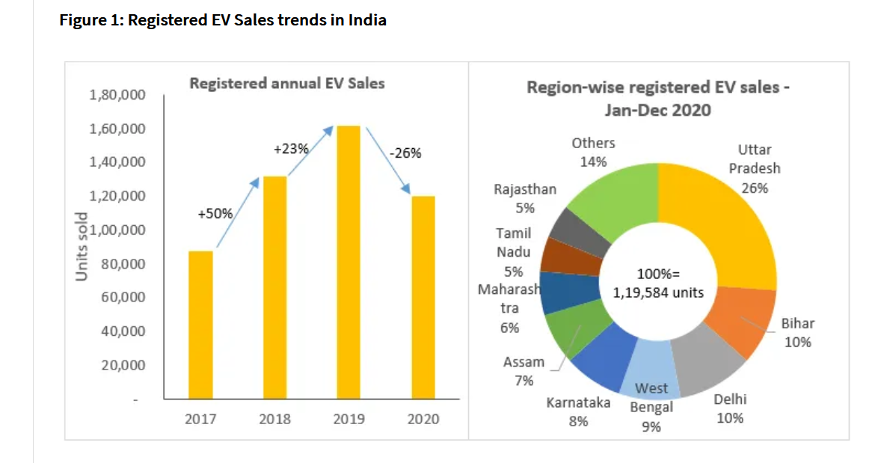
Reference: https://jmkresearch.com/registered-ev-sales-in-india-in-2020-dropped-by-26-on-yoy-basis/

Slide 13
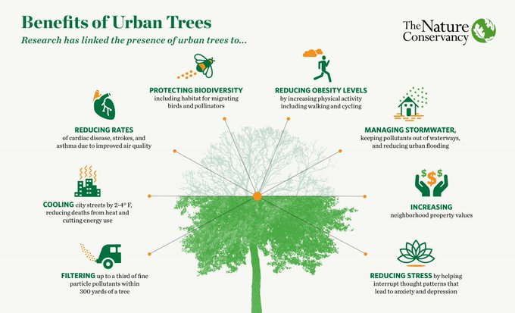

Slide 14
RESULT
The association between air quality and weather patterns can be quantified using statistical methods. The three most commonly used include: - The data is used to forecast concentrations based on weather conditions and correlated pollutant concentrations. Regression analysis estimates relationships between variables.
We have successfully predicted the possible variations in the Air Quality Index for the coming few years

Slide 15
The WOW in our solutions
Our project can actually save lives.
Our Project helps people plan ahead. If people are aware of variations in the quality of the air they breathe, the effect of pollutants on health as well as concentrations likely to cause adverse effects and actions to curtail pollution.
Prevention is better than cure.

Slide 16
NAME | ROLE
ARPIT KUMAR DHURIYA | Leader
NIHARIKA VERMA | Presenter
SUNIL MAURYA | Coder
TALIB KHAN | Coder
UNMESHNA SHIVHARE | Designer

Slide 17
THANKS!

